Slide 1
Real World Problems Uninformed Search Methods

Slide 2
Route Finding
Defined in terms of Specified Locations & transition along link between them.
Applications
Automated Travel Advisory System
Airline Travel Planning
Car Systems

Slide 3
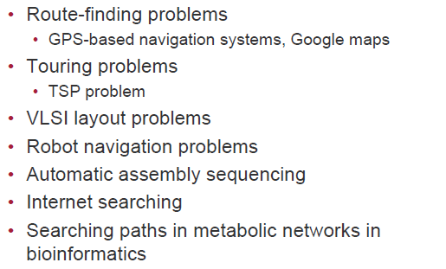

Slide 4


Slide 5


Slide 6
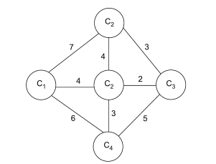

Travelling Salesman Problem

Slide 7

Problem Reduction Methods

Slide 8
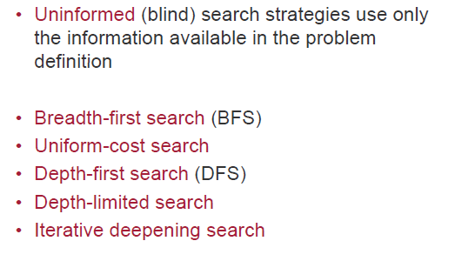
Search Methods

Slide 9

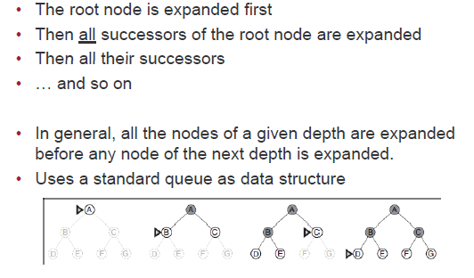

Slide 10
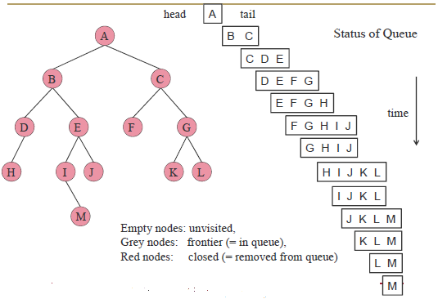

Slide 11

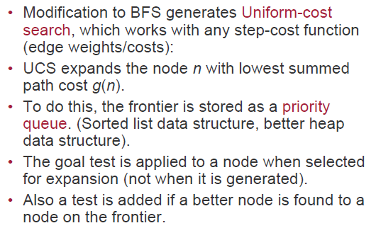

Slide 12
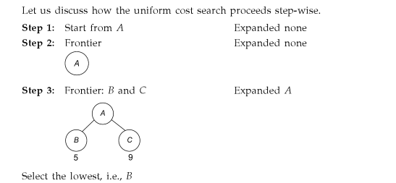

Slide 13

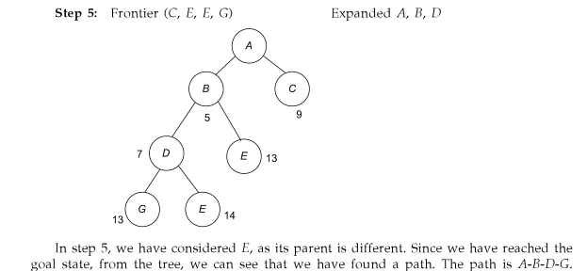

Slide 14
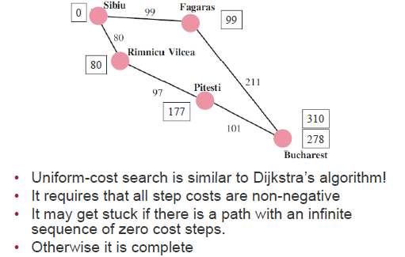

Slide 15


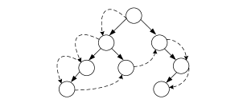

Slide 16


Slide 17


Slide 18
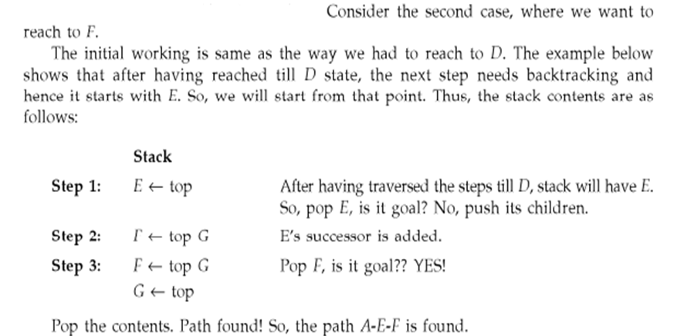

Slide 19



Slide 20


Slide 21


Slide 22
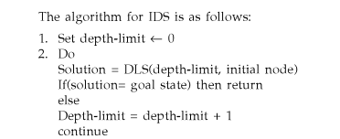

Slide 23


